Slide 1
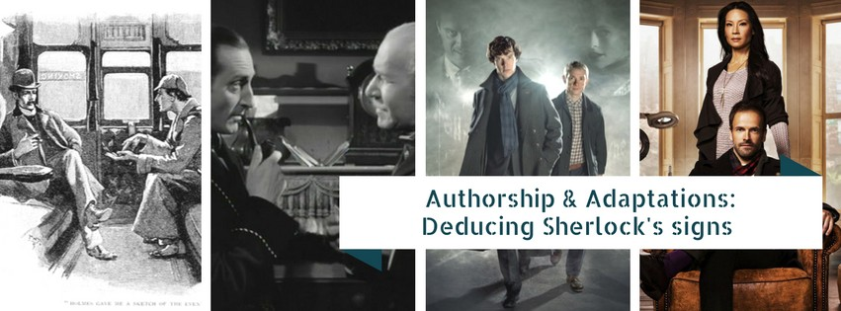
By Shannon McKemie
Fall 2016 M.A. EMAC candidate

Slide 3
“It is an illusion that transmogrifies recognizable matter into an imagining; reality into a representation, life into a shadow”
Vanacker, pg. 65
Notes:
“It is an illusion that transmogrifies recognizable matter into an imagining; reality into a representation, life into a shadow” –Maxim Gorky (1896)
Vanacker, pg. 65

Slide 4
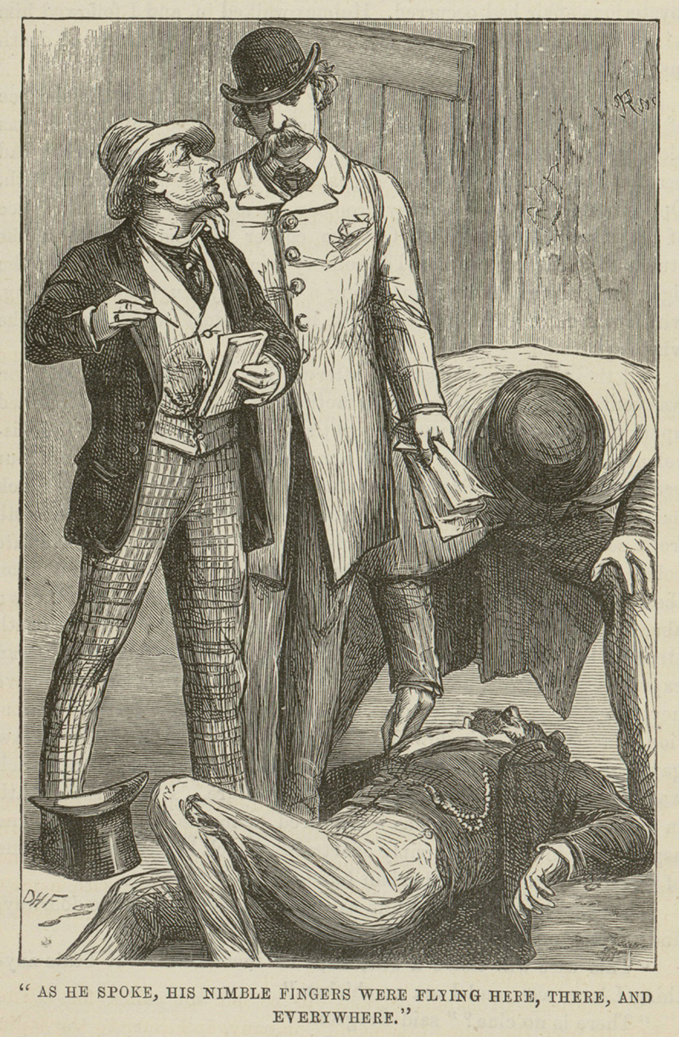
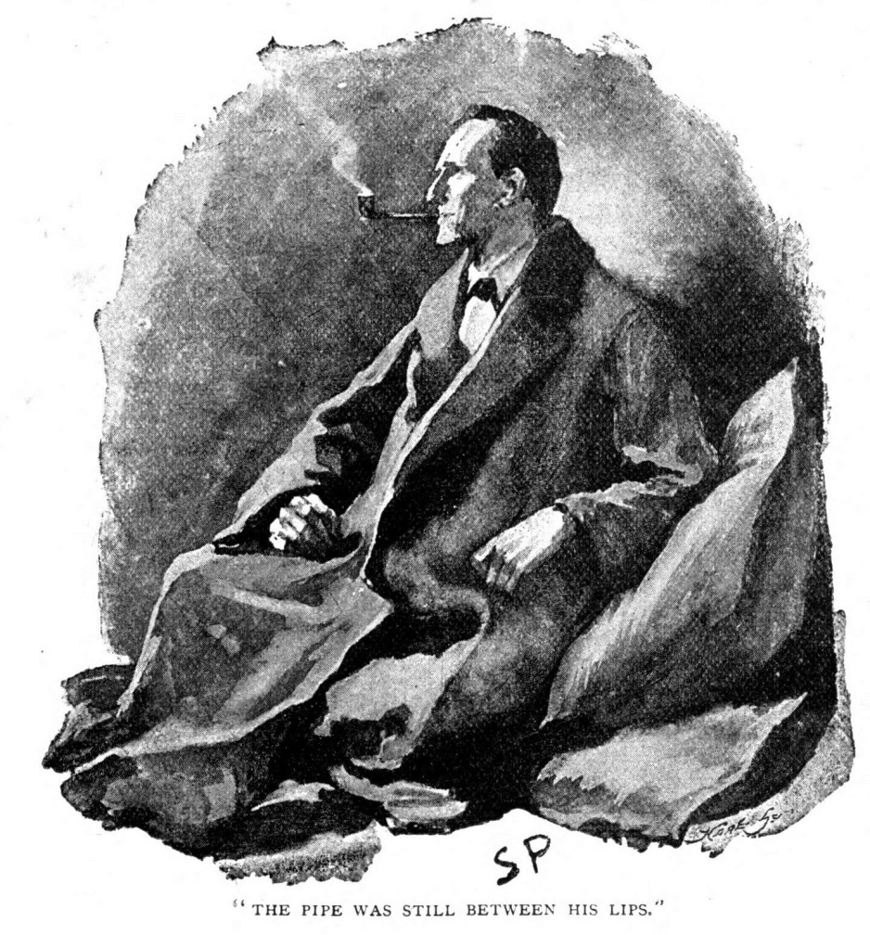
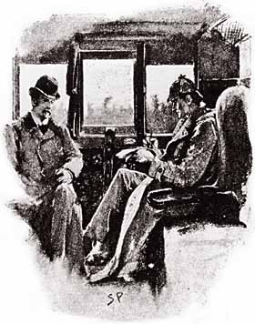
Notes:
1. The first transformation with Sherlock Holmes occurred with the illustrators. Doyle described Sherlock as: “ he was rather over six feet, excessively lean that seemed taller. His eyes were sharp and piercing with a thin hawk-like nose which gave an air of alertness and decision. His chin had prominence and squareness, his hands blotted with ink possessed delicacy of touch.”
Left hand side from A Study in Scarlet is D.H.Friston’s depiction of Sherlock Holmes with mustache and derby hat.
Right hand side shows Sidney Paget’s depiction of Holmes that by The Boscombe Mystery story in 1893 –Sherlock is wearing the deerstalker hat. Also, Sidney Paget modeled Sherlock after his brother Walter to make him handsome. Paget’s favorite hat was the deerstalker hat which became synonymous with Sherlock.

Slide 5
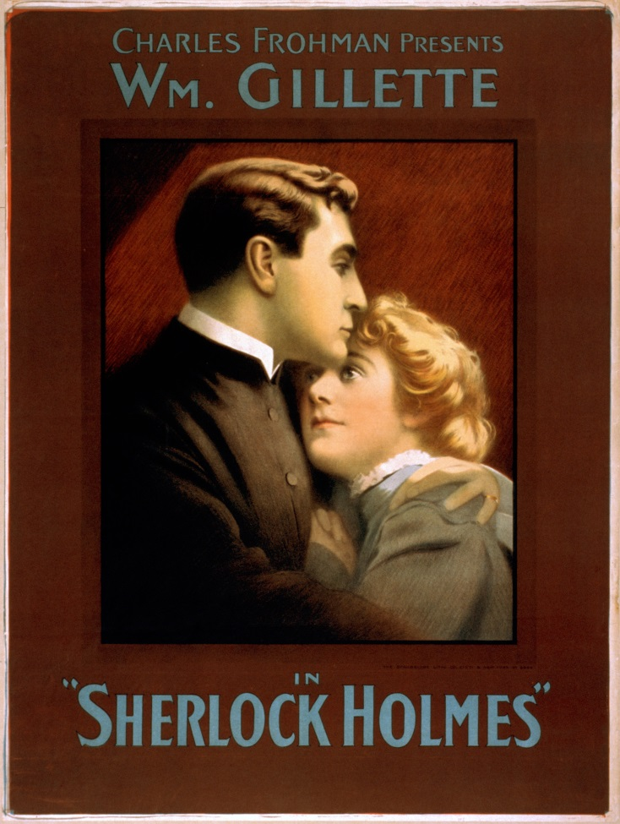
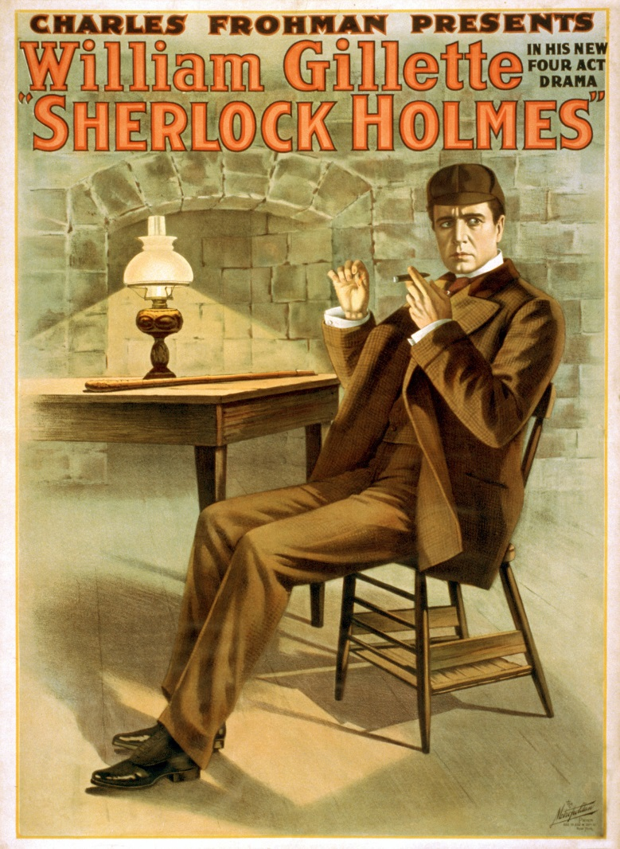
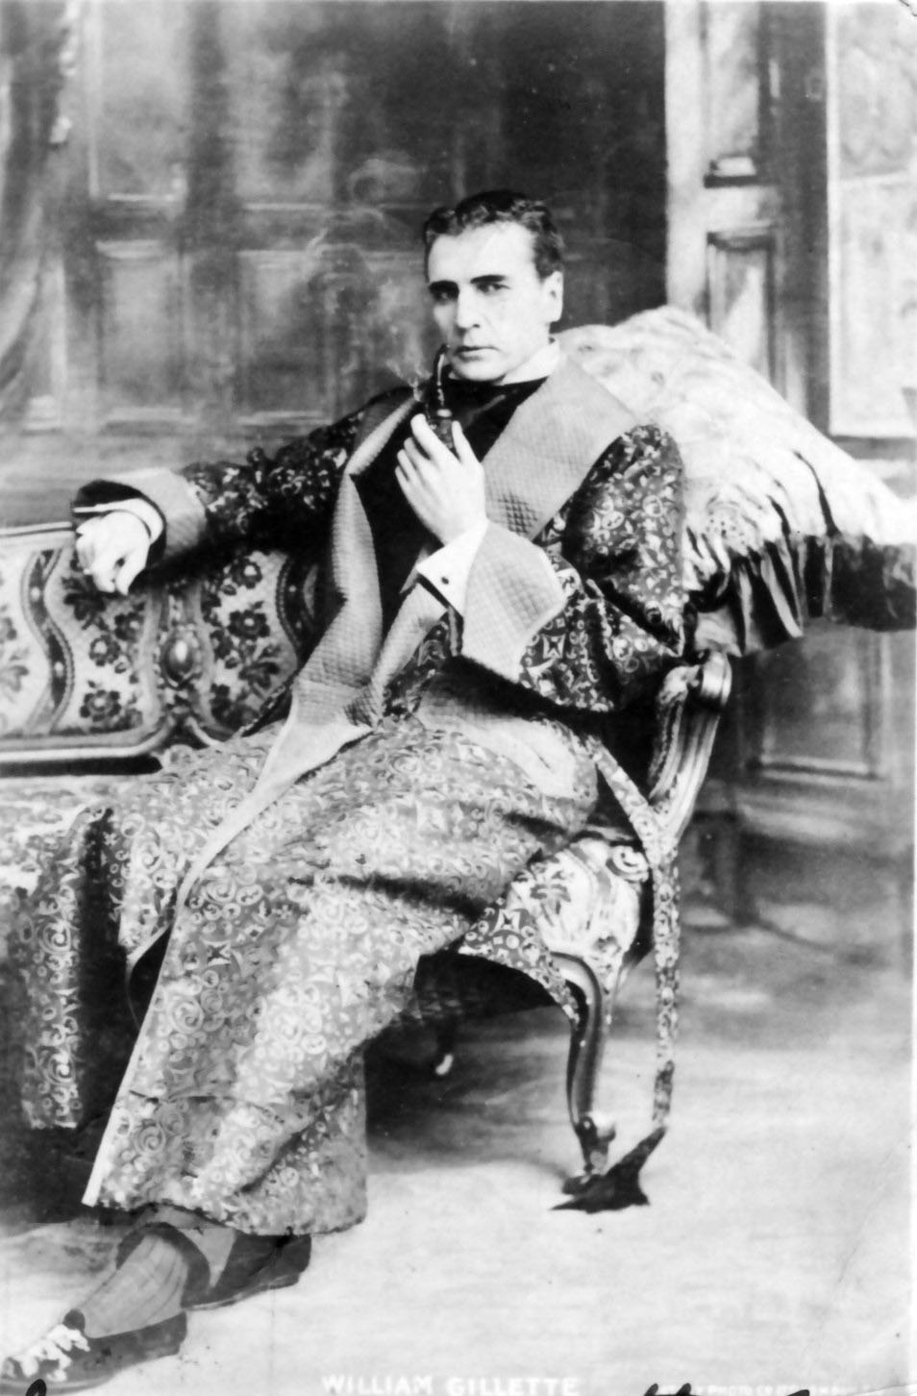
Notes:
The second transformation occurred with the American playwright and actor, William Gillette and his adaptation of the Sherlock Holmes stories. Gillette gave us , Sherlock’s calabash pipe and the phrase, “Elementary, my dear Watson”. His 1916 silent film, Sherlock Holmes was adapted from the Sherlock Holmes stories but mainly A Scandal in Bohemia. He changed Sherlock’s motivation to money rather than Doyle’s game and helping the police aspect. He also minimized Watson’s role and gave his own created character, Billy to act as Sherlock’s assistant. Lastly, he gave Sherlock a love interest in the character, Alice Faulkner.

Slide 6
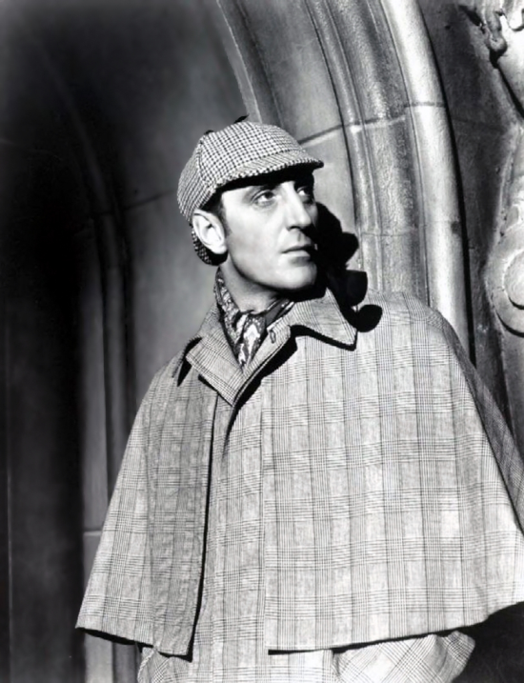
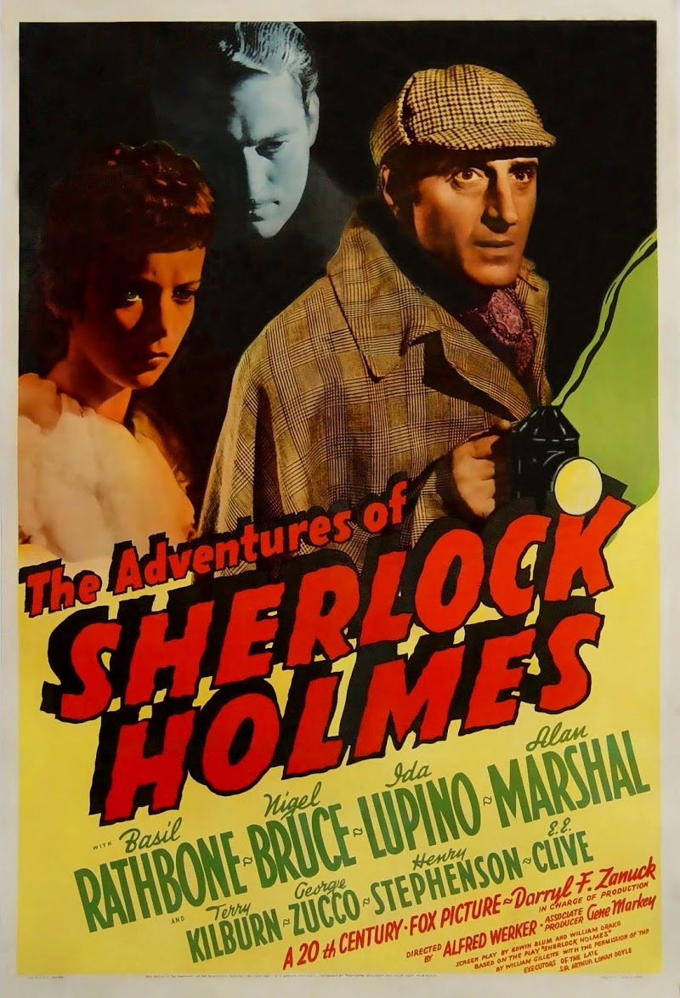
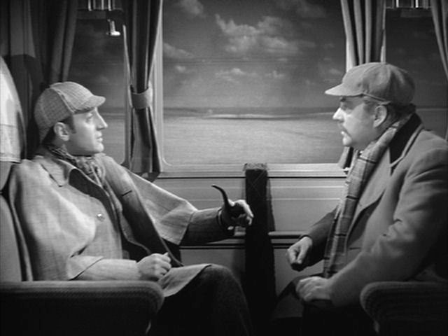
Notes:
3. The third transformation with Sherlock was Basil Rathbone’s portrayal from 1939-1946. The Rathbone Holmes is a “thinking machine, master of disguise, a connoisseur of the arts, and knows how to treat a lady but not interested in settling down with one, that can survive brushes with death” according to Leitch. Nigel Bruce’s Watson becomes a comical sidekick.

Slide 7
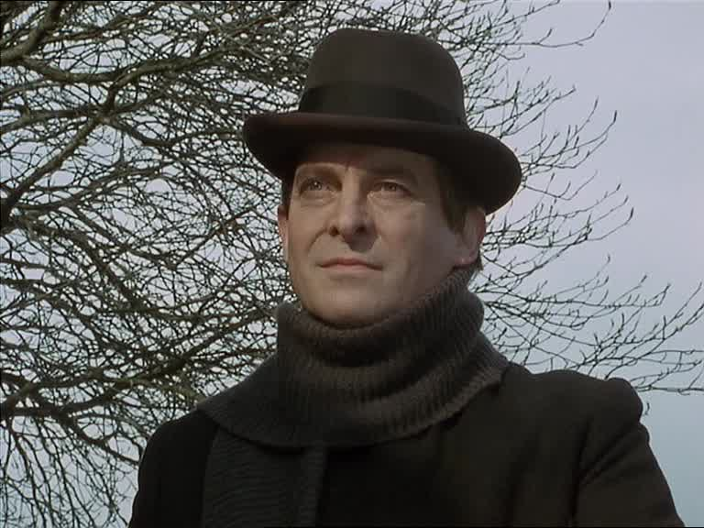
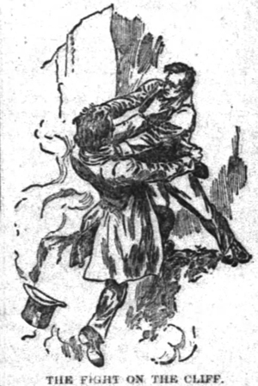
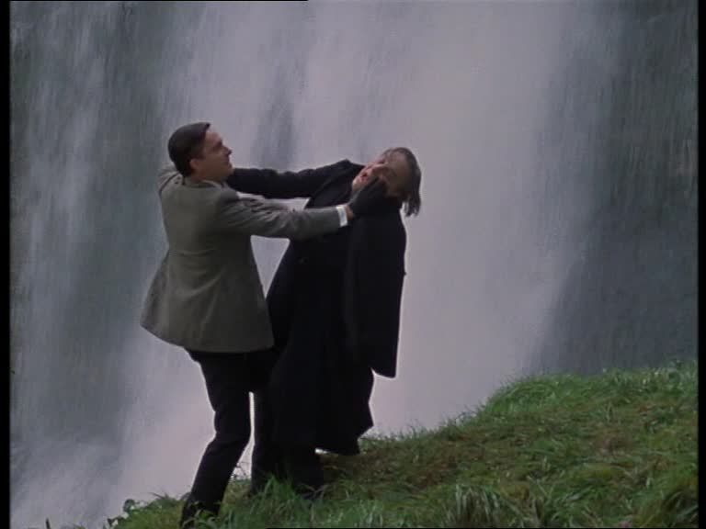
Notes:
4. The fourth transformation of Holmes was the Granada productions starring Jeremy Brett. Brett’s Holmes was a montage of expected conventions and mannerisms which he defined. Brett recreates Holmes in his own image as a theatrical manic-depressive whose historic outbursts repeatedly sacrifice fidelity to Conan Doyle for the sake of dramatic effectiveness

Slide 8
Notes:
5. The fifth transformation of Sherlock can be seen in the Cumberbatch/Freeman and Miller/Liu versions that are presently airing on BBC and CBS. The BBC version brings a media ecology with its textuality to let the audience see Sherlock’s thoughts and deducing. With its modernization Sherlock lives in a world without the Holmes canon. The Cumberbatch version brought a whole legion of new female fans into the fold. The Miller/Liu version brings a modern Sherlock to New York City and changes the gender of Watson and Moriarty/Irene Adler to female played by Lucy Liu and Natalie Dormer respectively.

Slide 9
