Slide 1
ShannonMcKemie.com
Authorship & Adaptations: Deducing Sherlock’s Signs Facebook page
@SherlockSigns Twitter account

Slide 2
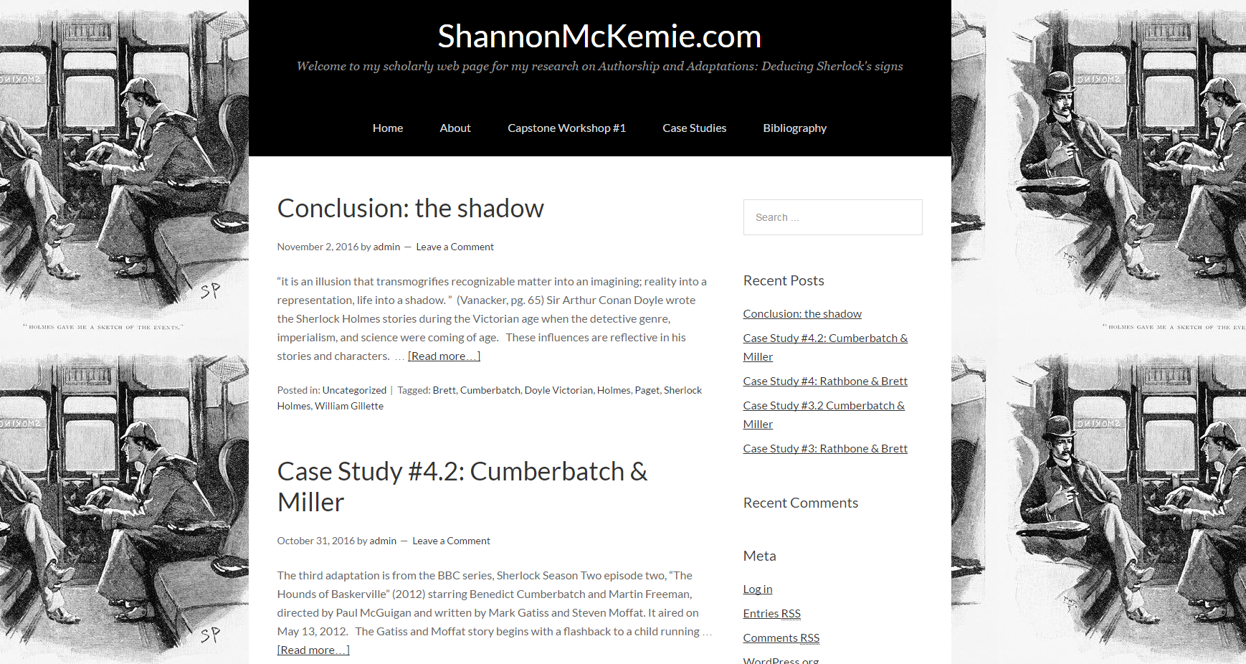
ShannonMcKemie.com

Slide 3
Bibliography : 12 books, 22 journal articles

Slide 4
“It is an illusion that transmogrifies recognizable matter into an imagining; reality into a representation, life into a shadow”
Vanacker
Each generation uses Doyle’s text and the previous adaptations to create their own unique Sherlock Holmes visual signature.
This matters as text and images are remediated both as new adaptations and in artwork; and is relevant as the EMAC program studies digital textuality.

